Slide 1
Graphical LCD PWM Wave Drawer
Prepared By: Ashraf Tarig Mohamed

Slide 2
Main points of the topic
Introduction
Components
Methodology
Configurability
Code Architecture
Flow Chart
Conclusion

Slide 3
Introduction
The idea of this project is to create a system that is functionally similar to an oscilloscope in the way that it draws a PWM wave onto a graphical LCD and providing its wave numerical characteristics by using a microcontroller that has an input capture unit.

Slide 4
Components
LGM12641BS1R graphical LCD: This is a 128x64 two page graphical LCD that is controlled by two KS0108B LCD driver integrated circuit such that each page is controlled using one of the two integrated circuits.
ATmega32 microcontroller: It is an AVR microcontroller with 32 GPIO pins which has a dedicated timer input capture unit. The reason for the selection of this specific microcontroller is its dedicated input capture unit.
DC power supply: A 5V DC power supply is needed for the operational power for the graphical LCD.
PWM wave source: It can be a separate microcontroller, a DC pulse generator or any device that is capable of the production of a PWM wave.

Slide 5
Methodology
A power supply of 5V supplies the graphical LCD with the operational voltage.
The microcontroller is connected to the LCD to send it data and commands so as to operate.
The PWM source, whether it was from the same microcontroller, another microcontroller or any other PWM source is connected to the input capture pin (PD6).
The PWM wave that is received by PD6 is processed by the microcontroller and the time of the high and low are both stored in two variables such that one stores the high and the other stores the low.
A piece of code is used where a loop is iterated for a number of times dictated by the values of the high and low variables scaled down by dividing it by a reasonable desired number. This loop draws the length of the signal when It is high or low.
Another piece of code is responsible for the drawing of the rising and falling edge of the signal.

Slide 6
Methodology
After the drawing of the signal reaches the end of the second page of the LCD, a function is called to write down the frequency and the duty cycle of the wave, then the image is maintained without any change for a few seconds using a delay function and after that the LCD is cleared and the same is repeated again until the system is stopped.
The drawing in the graphical LCD is done by setting so desired pixel value to high which in turn causes it to lighten up and the pixel that is not undesired is left on low which causes it to stay unlighted .
It a pixel is needed to be cleared, a value of 0 is sent to its location which sets it off.

Slide 7
Configurability
The system is configurable in the context of choosing which part of the PWM wave to capture first. Either the rising edge can be captured first or the falling edge.
This is decided via a macro that is defined in the timer1 header file. The name of the macro is First_Detected_Edge, it can be set to Timer1_FDE_Rising or Timer1_FDE_falling.

Slide 8
Code Architecture
This code has a layered architecture where the code is divided into sections that are distributed into separate layers which when they are combined, they produce the functional output that is intended by the code.
This ensures that the code is modular(the part where the application is written is separated from the rest of the code), portable(the same code can be used in several microcontrollers by preforming relatively minor changes mostly in the microcontroller abstraction layer), easily maintainable(since the code is divided into layers where each is responsible for a specific function, if an error occurs, It is easier to trace and inspect and therefor making it easier to fix) and reusable(for example, in this system, there is separate files that are responsible for dealing with the graphical LCD, the same files can be used in another project which makes the project reusable).

Slide 9
Code Architecture
The layers that form the code are:
APP (Application layer): contains the code written for the system application.
HAL (Hardware Abstraction Layer): contains the code related to any hardware component that is used in the project.
MCAL (Microcontroller Abstraction layer): contains the code that controls any peripheral that is inside a microcontroller.
Utility: it is the layer that handles common software and hardware handling such that it eliminates the need for duplicating long and complicated code pieces across the project.

Slide 10
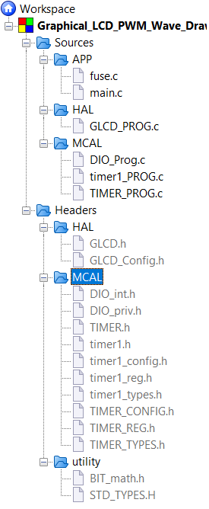
Code Architecture

Slide 11
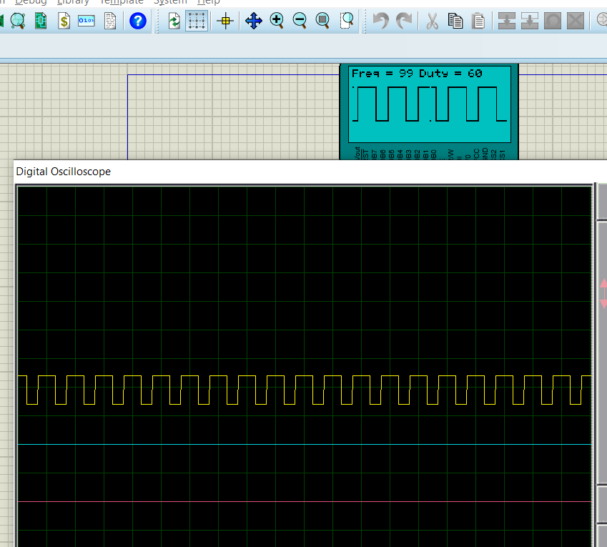
Output

Slide 12
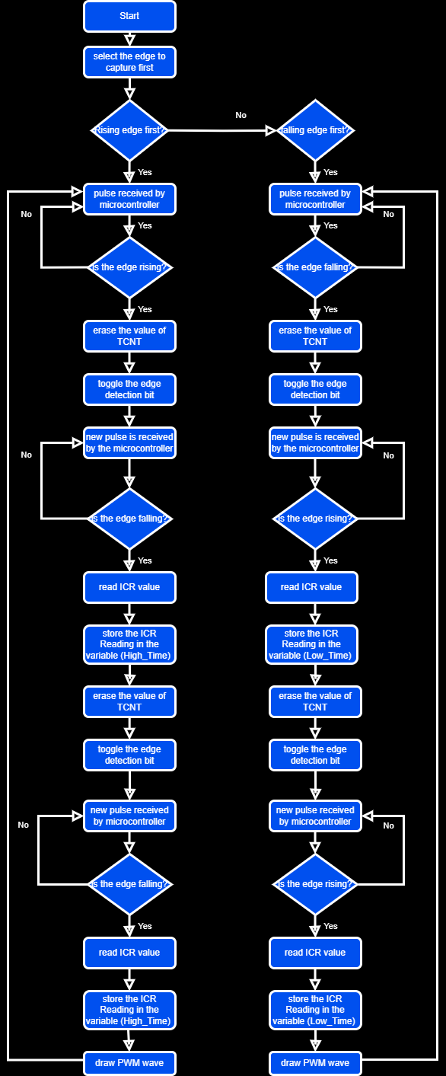
Flow Chart

Slide 13
Conclusion
As this code is designed to draw a PWM wave in a graphical LCD using basic logic, it is very much expected to not always operate in the optimal way. As an example of this, it has two modes of sensing, either sensing the rising edge first or the falling edge first and therefor, if it is not configured correctly, the system will give inaccurate results. The code will need a few tweaks in order to operate without the need for configuring the edge sensed first.

